Slide 1





Before you start
Parents: read our helpful guidance before you start
Mental health and emotional wellbeing
KS2 (Y3-4)
Home learning lesson: Expressing feelings
To start, play this slideshow from beginning

Slide 2

Y3-4 home learning:
Expressing feelings

Slide 3



      We are learning about expressing feelings
      We will be able to:
  name a range of feelings and emotions
  match feelings to a scale of intensity and identify strong feelings
  describe different feelings and how they are experienced in the body
  recognise why it is important for people to express their feelings

Slide 4



Expressing feelings:
What’s our starting point?
Make a ‘feelings’ graffiti board.
On a piece of paper, jot down all of the words you can think of to describe feelings and emotions.

Slide 5
Feelings thermometers
Read the words from the Feelings match up sheet (Resource 1 in your worksheet pack).
overjoyed
Find the root words first.
Now match the similar feelings words together
Then organise them in order of intensity
  Which is the biggest feeling?
Write it down on a piece of paper like this example.
delighted
satisfied
pleased
Pleased is the root word and overjoyed is the biggest, strongest or most intense feeling.

Slide 6


Expressing feelings
Choose one of the words that describes a ‘big’ feeling from your lists.
Now draw or write on the Body outline sheet (Resource 2 in your pack).
Where in the body might someone have that feeling?
If the feeling had a colour, what would it be?
If it had a shape, what would it be?
If it had a texture, what would it be?
If the feeling had a sound, what would it be?
If the feeling were an image or a picture, what would it be?

Slide 7




Feelings imagery
Thinking of images can help us describe strong or intense feelings.
What feelings do these images make you think of?

Slide 8



Writing about feelings
Write a sentence to match each picture and describe the feeling you think it best represents.
For example: Like a little cat, outside and lost in a snowstorm, she felt lonely and afraid.

Slide 9
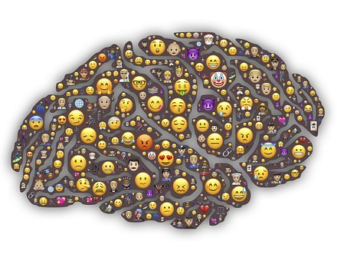
Why is it important to express feelings?
Expressing our different feelings helps us to recognise and manage them.
Expressing feelings can help stop strong or intense feelings from taking over our minds and bodies.
It helps us recognise when we might need help with our feelings.
Sometimes it is good for others to know how we are feeling — it helps them to help us.

Slide 10







Ways to express feelings
What are some of the different ways people can express their feelings?
art – drawing, painting, collage
talking to others
writing – diaries, poems, stories, blogs
face and body
music
acting, dancing and singing

Slide 11

Remember!
Expressing our feelings is important — it helps our minds stay well. There are many ways you can do this but talking to an adult you trust is one of the best ways.
If you are worried about any feeling, always talk to a trusted adult about it.
Talk to a trusted adult at home or at school
If you want to talk to someone other than a parent or teacher, ChildLine can help. See:
https://www.childline.org.uk/get-support/ or phone 0800 1111
ChildLine: www.childline.org.uk
0800 1111

Slide 12


Expressing feelings:
Where are you now?
Go back to the ‘graffiti board?’ activity you did at the start.
Have you learned any new words or ways to describe feelings and emotions?
Add them to your graffiti board using a different coloured pen or pencil.

Slide 13

Additional activity
Produce a piece of artwork (a painting or collage) or descriptive writing (a poem or the beginning of a story) about feelings.

