Slide 1



Maintaining our Dental health
Play this slideshow from beginning

Slide 2



  We are learning about the importance of dental health routines
      We will be able to:
      identify how everyday actions affect dental health
      describe ways to maintain good dental health
      explain common risks to dental health and how to manage them
© PSHE Association 2019

Slide 3

What’s our starting point?
Ideas pool
Write your ideas about keeping teeth healthy by answering these questions:
  What can help to keep teeth healthy?
  What might damage teeth?
  Why is it important to look after our teeth?

Slide 4
Key word match-up
Can you match the word to the meaning?
Enamel
ways to keep teeth clean
tiny holes in the tooth caused by a
build-up of plaque
Plaque
Cavity
hard, outer layer of the tooth
soft, sticky film that builds up on teeth and contains bacteria
Oral hygiene

Slide 5
Key word match-up ANSWERS
Enamel: hard, outer layer of the tooth
Plaque: soft, sticky film that builds up on teeth and contains bacteria
Cavity: tiny holes in the tooth caused by a build-up of plaque
Oral hygiene: ways to keep teeth clean

Slide 6
Everyday Actions
The Everyday actions cards are a mix of actions that can affect our dental health.
On a piece of paper, draw three columns with the headings:
positive actions ✓
negative actions X
not sure/depends ?
Write the card numbers in the correct column.
✓
X
?

Slide 7
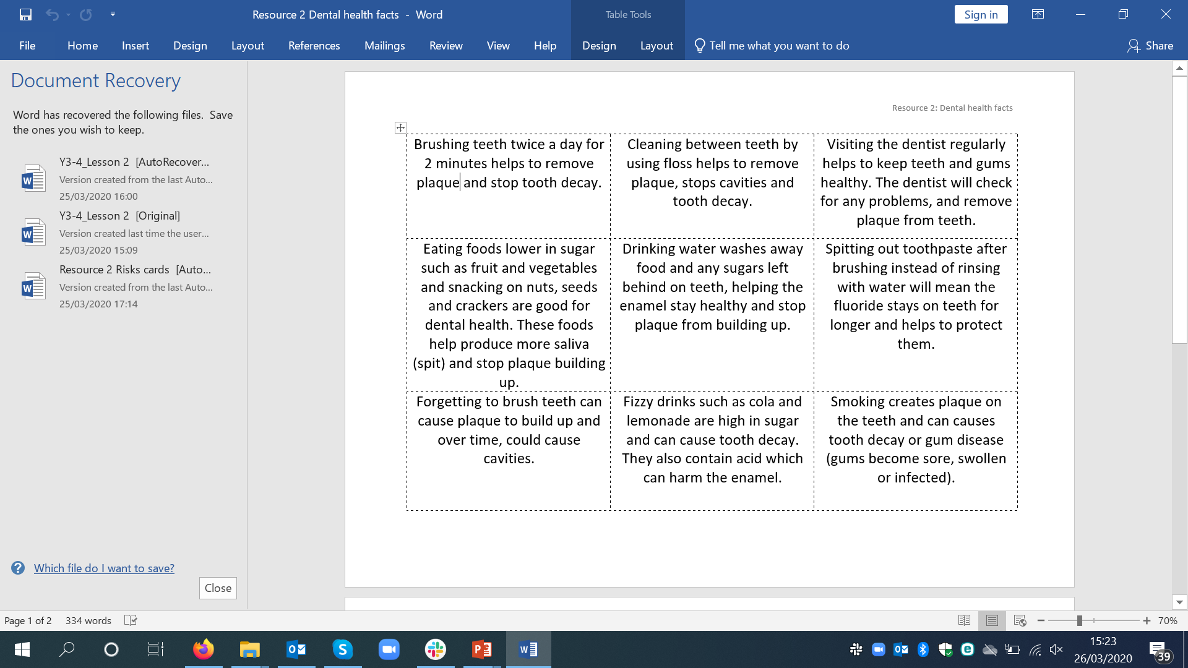
Dos and Don’ts
Use the Dental health facts in your worksheet pack along with the Everyday actions to create a list of Dos and Don’ts for maintaining good oral hygiene.
Example:
Dos Brush teeth for 2 minutes — to keep them clean and get rid of plaque
Don’ts Rinse with water after brushing — it washes away the fluoride in the toothpaste

Slide 8

Dental dilemmas
Choose 1 or 2 dilemmas (from ‘Dental dilemmas’ in your worksheet pack) and come up with solutions for the character using the following questions:
1. What actions might affect the character’s dental health?
2. What information might help the character in this situation?
3. Who can help them with the dilemma?

Slide 9
Sam
Lea
If not treated by a dentist, Sam’s toothache could get worse and cause more serious issues.
Sam should eat fewer sweets because the sugar is causing harm to their teeth.
So that the situation can be resolved quickly, Sam could talk to a parent or trusted adult so that they can make an appointment with the dentist.
Click this box to reveal the answer
If Lea’s sister doesn’t brush her teeth, it could cause plaque to build up.
Lea could tell her sister about the importance of brushing teeth twice a day.
Lea could brush her teeth each day at the same times as her sister or help her create a brushing routine poster or chart to remind her. In addition, Lea should let a parent or carer know what is happening, so that they can help with a brushing routine.
Click this box to reveal the answer

Slide 10
Bailey
Jesse
Click this box to reveal the answer
Click this box to reveal the answer
Using mouthwash and chewing gum can help to prevent plaque from building up.
But, as long as Jesse is following a good oral hygiene routine e.g. brushing twice a day for 2 minutes and eating foods lower in sugar, then chewing gum and mouthwash are extras rather than necessities.
Jesse could ask for advice from a parent/carer or dentist if not sure what is best for their teeth.
1. & 2.
    Bailey shouldn’t worry too much, it is normal for teeth to fall out at different times and it happens to children at different stages.
  Bailey could also let a parent or carer know about his worries so that they can talk them through.

Slide 11
Yasmin
Mohammed
Click this box to reveal the answer
Click this box to reveal the answer
Fruit juice is a drink high in sugar (14.7g in one small glass).
Yasmin should ensure she is drinking the recommended daily limit of 150ml (small glass) of fruit juice a day.
Yasmin could also let a parent or carer know about the sugar content of juice.
Mohammed should have his tooth taken out to avoid the problem getting worse.
  It could help Mohammed to talk to a parent, carer or trusted adult about how he is feeling.
Mohammed’s parent could let the dentist know he is feeling nervous so that they can take him through the appointment slowly, and reassure him about what to expect.
2. & 3.

Slide 12

Maintaining our dental health
Well done for completing the activities!
Now go back to the ‘What’s your starting point?’ activity
Ideas pool
Is there anything you would like to change?
Is there new information that you can add now?

